Slide 1
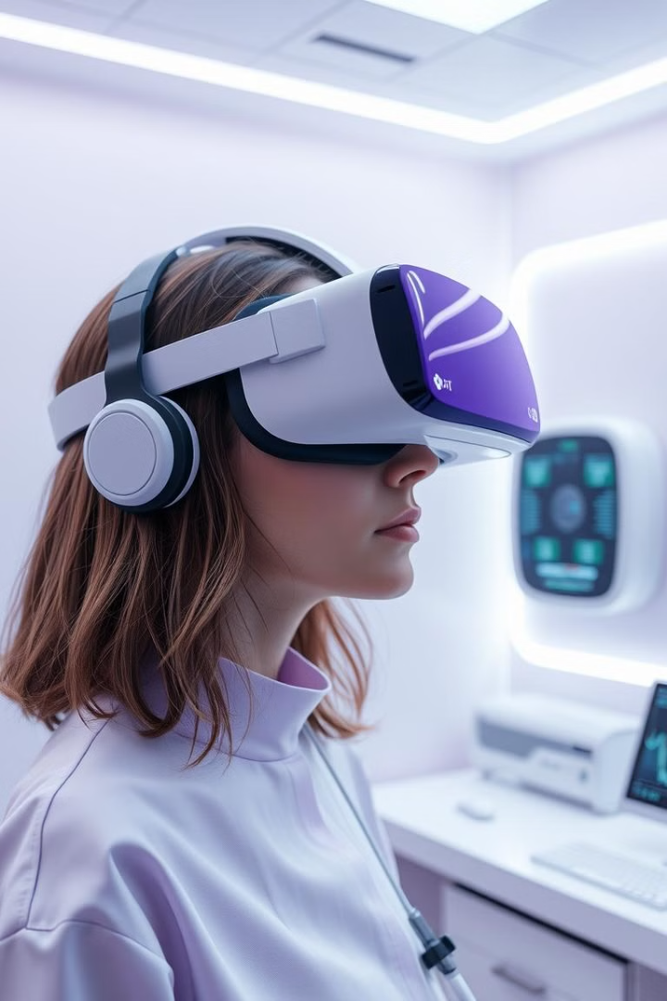
Revolutionizing Healthcare: The AI & VR Synergy
Discover the transformative power of AI and VR in healthcare. These address current challenges like accessibility, cost, and treatment personalization. AI-powered VR is set to revolutionize healthcare delivery and improve patient outcomes.
The VR/AR healthcare market is projected to reach $7.96B by 2028. The AI in healthcare market is expected to reach $103.7B by 2028.

Slide 2
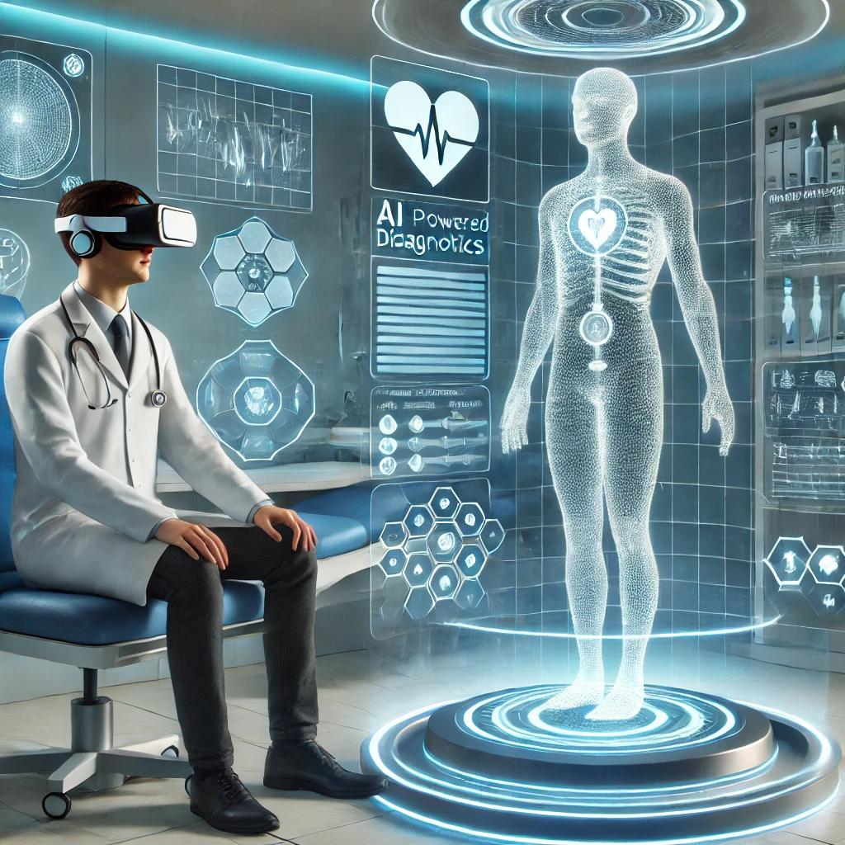
AI-Powered VR: Diagnostics and Treatment
Precise Diagnostics
Personalized Therapies
AI algorithms analyze patient data in VR for precise diagnostics.
AI guides VR therapies, optimizing treatment plans.
Example: AI eye movement analysis in VR detects neurological disorders with 90% accuracy.
Example: AI tailors PTSD VR therapy, reducing treatment time by 30%.
AI Tutors
AI tutors guide users in VR, with feedback and personalized learning.
Example: Surgical training in VR improves skill acquisition by 45%.

Slide 3

VR Pain Management & Rehabilitation
Pain Distraction
Enhanced Rehab
Gamified Compliance
AI-driven VR environments distract from pain.
AI-enhanced VR rehabilitation adapts to patient progress.
Gamified VR and AI improve patient compliance.
VR pain distraction during burn wound care reduces pain by 50%.
AI prompts and rewards increase patient engagement by 60%.
Stroke rehab with AI-powered VR games improves motor function recovery by 40%.

Slide 4




Mental Health Support via VR
Virtual Therapists
Early Detection
Data Privacy
AI analyzes VR interaction for early issue detection.
HIPAA compliance is critical.
AI therapists offer personalized support.
AI predicts depression with 85% accuracy.
VR helps improve communication skills by 35%.

Slide 5


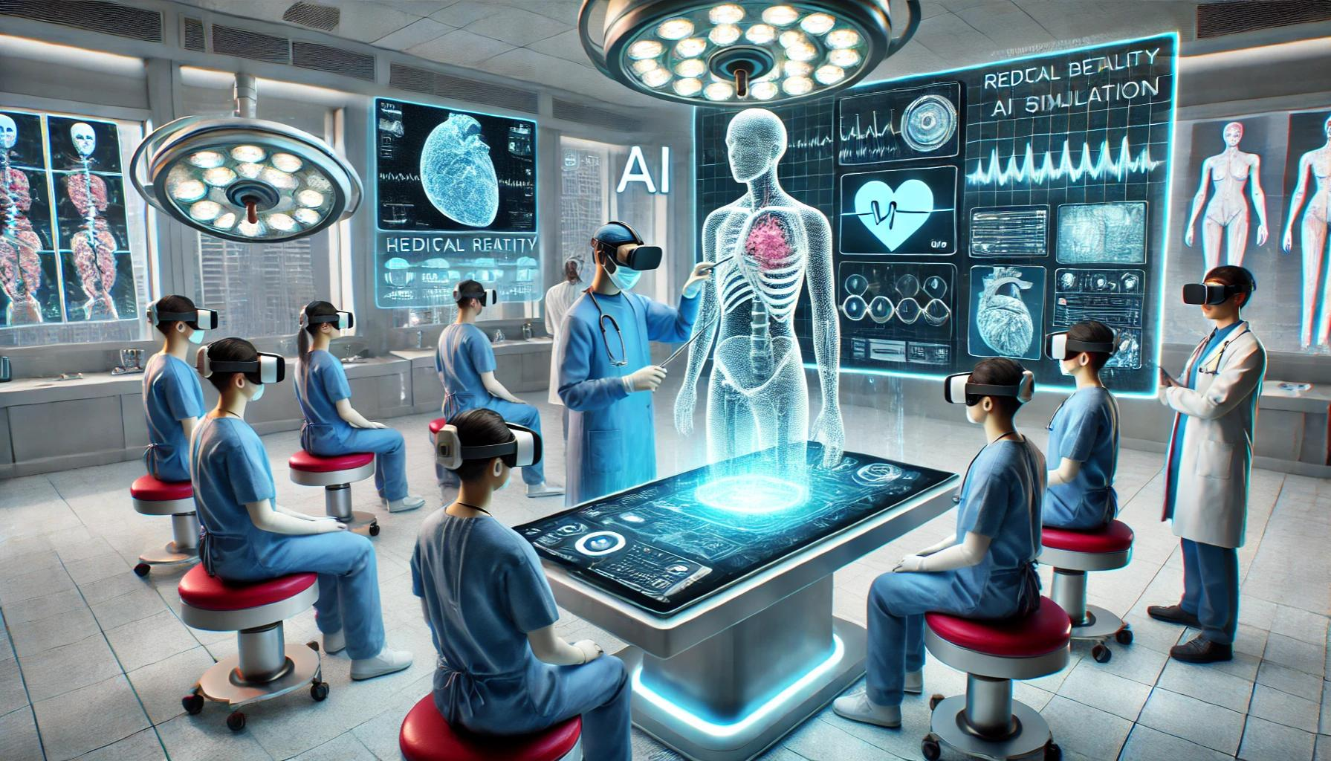
Medical Training and Education via AI in VR
Realistic Simulations
Personalized Learning
Realistic VR simulations are enhanced with AI.
Personalized learning paths for medical students.
AI increases knowledge retention by 20%.
AI-driven surgical simulations reduce errors by 25%.

Slide 6
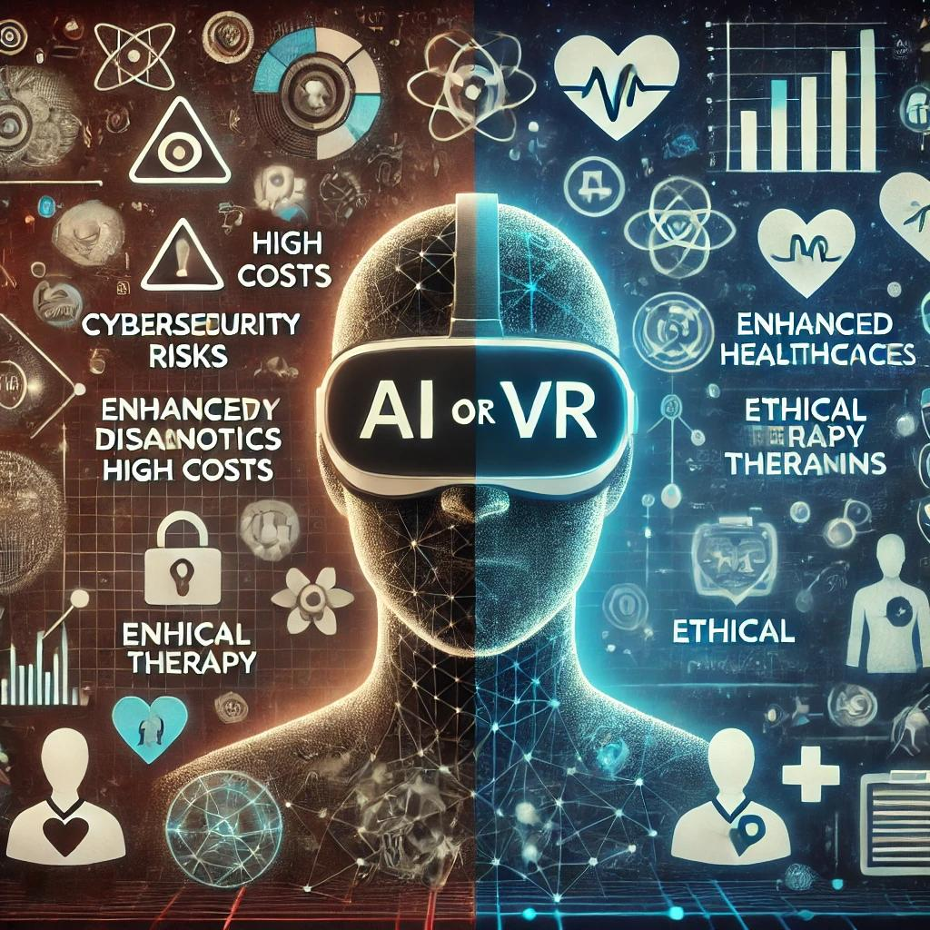
Challenges and Opportunities
Data Security
1
Patient privacy regulations
2
Accessibility
Affordability of VR/AI
Unbiased AI
3
Ensuring unbiased algorithms
5
Clinical Validation
Regulatory approval needed
Collaboration
6
Partnerships are essential

Slide 7
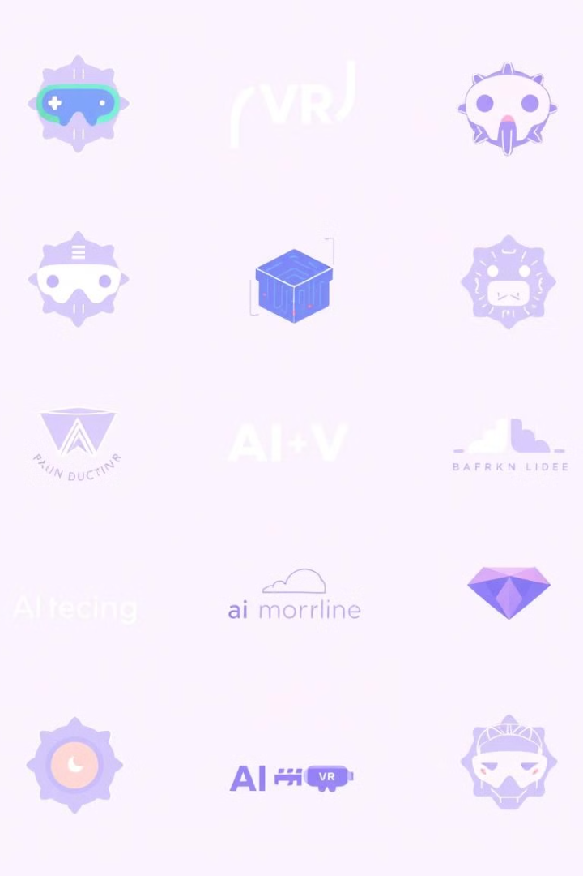
Tools and applications used
Unity
Real-time 3D development platform
Unreal Engine
Advanced real-time 3D creation tool
TensorFlow
Open-source machine learning framework
PyTorch
Open-source machine learning framework

Slide 8
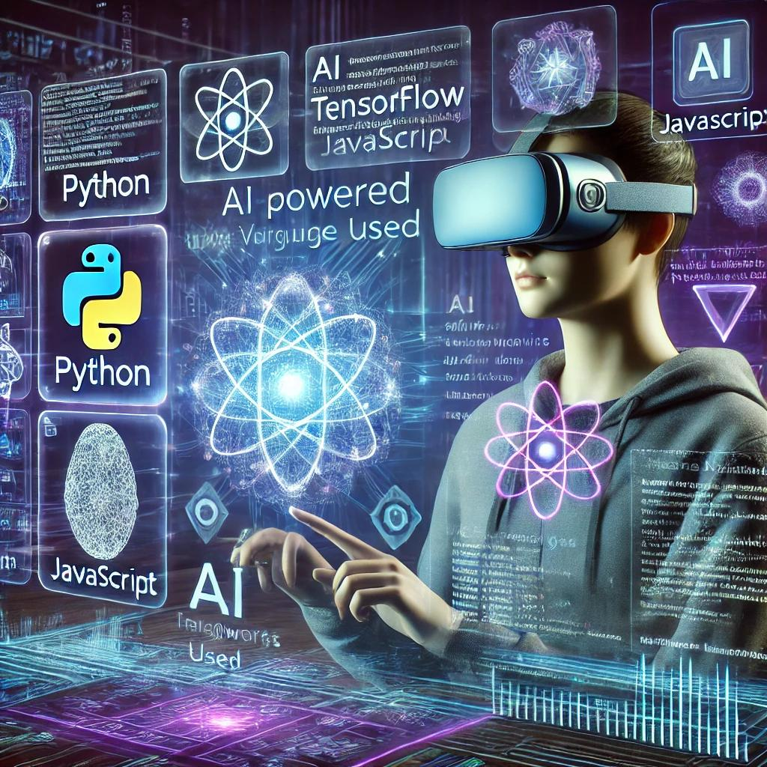




Languages and Technology used
C#
C++
Used in Unreal Engine
Primary language for Unity
2
1
Python
VR Headsets
Oculus, HTC Vive, etc.
4
3
Popular for AI development

Slide 9
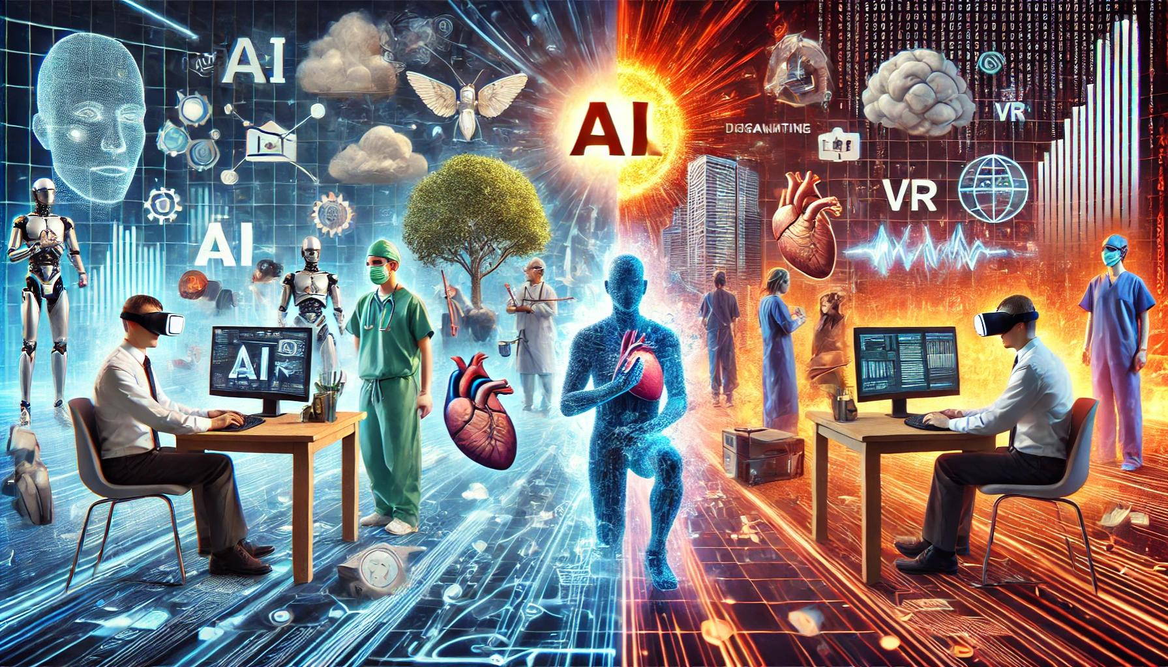
Advantages and disadvantages of AI in VR health care
Advantages
Disadvantages
Improved accuracy
High costs
Personalized treatments
Data security risks
Enhanced training
Ethical concerns
Increased access
Lack of human touch

Slide 10

The Future of Healthcare is Here: Embrace AI & VR
AI and VR are converging to revolutionize healthcare. This means improved diagnostics, personalized treatment, and enhanced patient outcomes. The market is vast and growing.
Explore, invest, and collaborate to shape the future of AI-powered VR healthcare. The future of healthcare is now.

